Slide 1

AutoCAD 2D PCB Design - Electronic Calling Bell
An overview of the design and functionality.

Slide 2
Introduction
This presentation provides a detailed overview of the AutoCAD 2D PCB design for an electronic calling bell. It outlines the project's objectives, technical details, and the design process utilized to create a functional and efficient circuit board.

Slide 3

01
Overview of AutoCAD 2D PCB Design
.

Slide 4
Introduction to PCB Design
Printed Circuit Board (PCB) design is crucial for the functionality of electronic devices. It converts schematic diagrams into physical layouts that ensure electrical components connect properly. This process involves meticulous planning and execution to guarantee optimal performance.

Slide 5
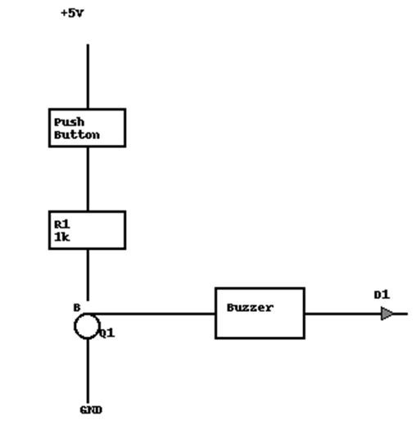
Schematic Diagram Overview
The schematic diagram serves as a blueprint for the electronic calling bell. It visually represents the connections and functional relationships between components, allowing designers to verify the design's accuracy. This diagram is essential for troubleshooting and ensuring correct assembly of the PCB.

Slide 6
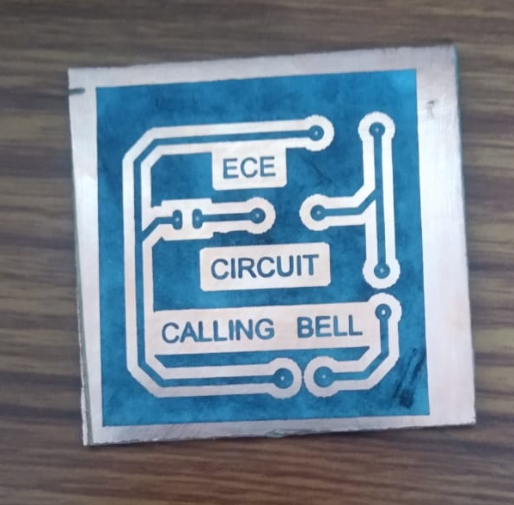
PCB Layout Design Elements
The PCB layout is meticulously structured to optimize space and functionality. Key elements include designated areas for power, ground, and signal traces, ensuring minimal interference. The design adheres to industry standards for track widths and clearances, crucial for reliable operation of the electronic calling bell.

Slide 7

Component Placement Strategies
Effective component placement on the PCB is vital for performance and manufacturability. Components are arranged to minimize signal paths, reduce noise, and facilitate heat dissipation. This strategic placement aids in simplified assembly and testing processes, promoting overall efficiency in the design workflow.

Slide 8
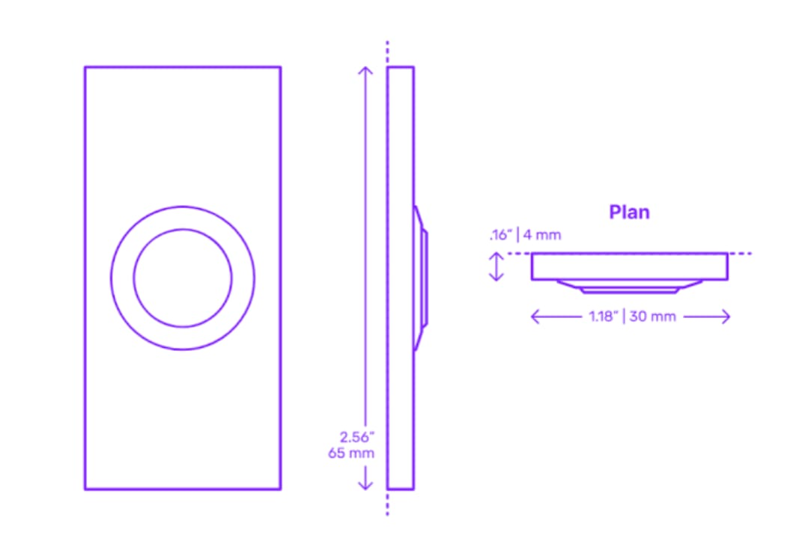
Electronic Calling Bell In 2D AUTOCAD
An electronic calling bell, also known as a doorbell, can be represented in 2D AutoCAD drawings. These drawings typically show the bell's components, such as the push button, wiring, and the bell mechanism itself, from various views like plan, elevation, and section. The drawings often include dimensions, labels, and other details necessary for installation and understanding the bell's functionality.

Slide 9
Purpose And Conclusions
.
The goal of this project is to design a simple electronic calling bell circuit using 2D AutoCAD. It helps visualize how components are placed and connected, making it easier to understand basic circuit design and PCB layout. This is a great starting point for students learning electronic schematics.
The calling bell circuit was clearly laid out using 2D AutoCAD, showing all components and connections. It highlights how CAD tools help in planning and documenting circuits. Students also get practical experience in drawing and aligning components for real-world use.

Slide 10
Thank you!
.
Team members:
22A91A04Q1 22A91A04P4 22A91A04N2

